Slide 1
Lecture 6 Address Translation
Prof. Yinqian Zhang
Fall 2024

Slide 2
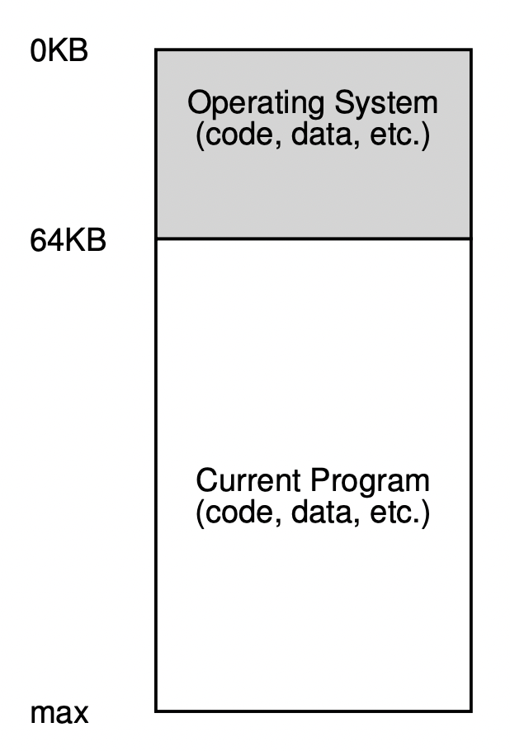
Operating System in Early Days
The OS is a set of routines (a library) that uses lower memory
Starting at physical address 0 in this example
One running program uses the rest of memory
Starting at physical address 64k in this example

Slide 3
Multiprogramming and Time Sharing
Multiprogramming [DV66]
Multiple processes ready to run at a given time
OS switches between them, e.g., when one decided to perform I/O.
Benefit of multiprogramming
Time sharing of computer resources
More effective use of CPU
What about physical memory?
Moving data in/out of memory is slow
Process 1
Process 2
[DV66] Jack B. Dennis, Earl C. Van Horn. “Programming Semantics for Multiprogrammed Computations”. 1966

Slide 4
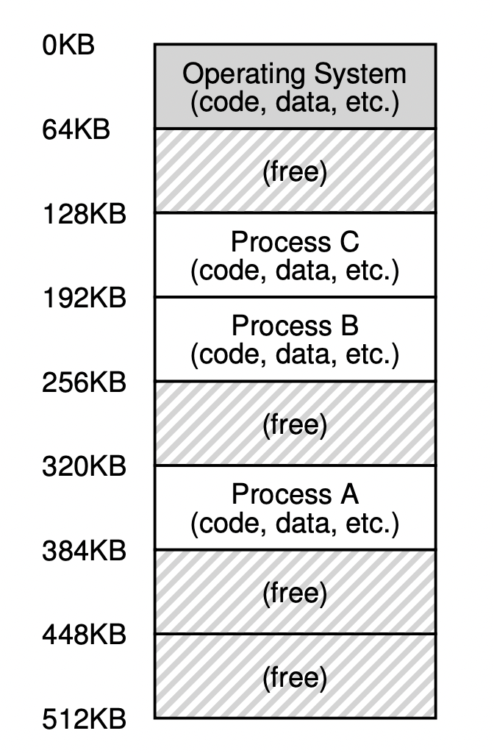
Multiprogramming with Memory Partition
Solution:
Leave processes in memory when switching
Each process owns a small part of the physical memory that is carved out for them.
New demand for complex memory management

Slide 5
Multiprogramming with Memory Partition
Potential issues:
What happens when Process C needs more memory?
How to compile Program B so that it knows it will run at 192KB?
What if Process C has an error and writes to address at 1KB or 330KB?

Slide 6
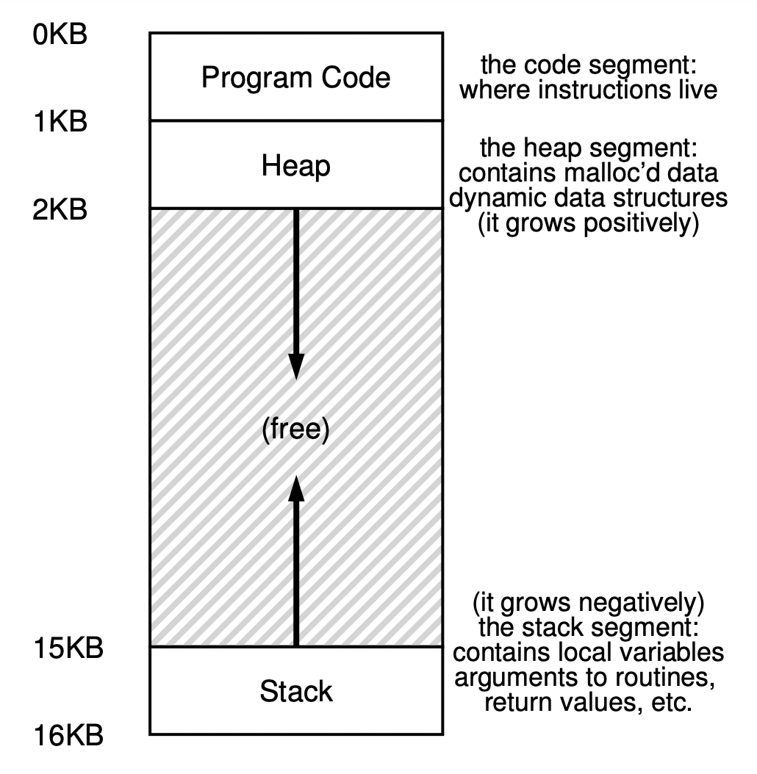
Address Space
Address space is an important OS abstraction
Address space is a process’ view of memory in the computer system
Segments in an address space
Code segment: instructions at the bottom
Stack segment: local variables, arguments, return values
Heap: malloc
Stack and Heap need to grow

Slide 7
Address Space (Cont’d)
0KB
Program code
This 16KB address space is just an abstraction
0KB in the address space is not 0KB of physical memory
This 16KB address space is just an illustration
32-bit CPU supports up to 2^32 Byte (4GB) address space
64-bit CPU supports up to 2^64 (4EB) Byte
But most CPU would reserve higher address bits
x86-64 supports only 2^48 Bytes (256TB) address space
Heap
Library
Library
Stack
4GB

Slide 8
Memory Virtualization
0KB
Program code
An abstraction of a private, large address space for multiple running processes on top of a single, physical memory
Virtual address
Address in a process’ own address space
Physical address
Address of the physical memory
Address translation
Virtual to physical address translation
example: 0KB -> 320KB
Heap
Library
Library
Stack
4GB

Slide 9
Aside: Addressing Memory
Memory address is the address of a BYTE
1 byte = 8 bit
how to address a bit?
Address representation
hexidecimal: 0x8c
decimal：140
binary: 0b10001100
Big endian or little endian
32-bit int at 0x8c
big endian: 0x d1 4a f5 83
little endian: 0x 83 f5 4a d1
how to address this bit?
0b10001100
1
1
0
1
0
0
0
1
0b10001101
0x4A
0b10001110
0xF5
0b10001111
0x83

Slide 10
Memory Virtualization (Cont’d)
A mechanism that virtualize memory should
Be transparent
Memory virtualization should be invisible to processes
Processes run as if on a single private memory
Be efficient
Time: translation is fast
Space: not too space consuming
Provide protection
Enable memory isolation
One process may not access memory of another process or the OS kernel
Isolation is a key principle in building reliable systems

Slide 11
Virtual Address v.s. Physical Address
Process uses virtual addresses
1. #include <stdio.h>
#include <stdlib.h>
int main(int argc, char *argv[]) {
printf("code : %p\n", main);
printf("heap : %p\n", malloc(100e6));
int x = 3;
printf("stack: %p\n", &x);
return x;
}
$ ./mem_layout
code : 0x1095afe50
heap : 0x1096008c0
stack: 0x7fff691aea64

Slide 12
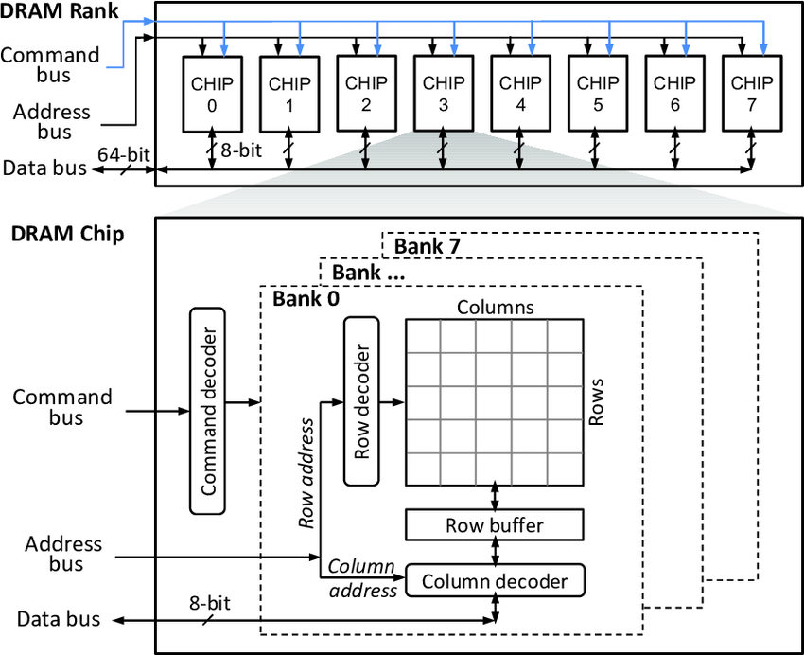
Virtual Address v.s. Physical Address
CPU uses physical addresses to access DRAM
CPU
DRAM
ExecutionUnit
0x10000
virtual address
Memory Management Unit
physical address
Memory Bus

Slide 13

Address Translation
MMU is usually on the CPU chip, but may also be off-chip or pure software
Coordination between CPU hardware and OS software
Memory management unit (MMU) in CPU
Translate virtual address used by instruction to physical address understood by DRAM
CPU interposes every memory access
Interposition: a generic and powerful technique used in computer systems for better tranparency
Operating system
Set up hardware for correct translation
Keep track of which locations are free and which are in use
Maintain control of how memory is used

Slide 14
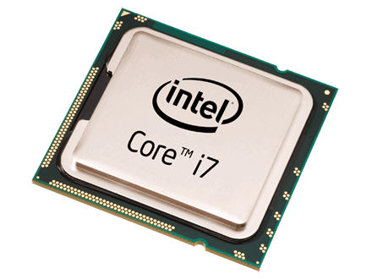
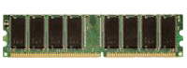
Address Translation in Action
Step 1: Fetch instruction at virtual address 0xabcdef00
MMU
0xAAAAAA00
0xAAAAAA00
PC
0xABCDEF00
0xAAAAAA00
ld a1, 0(a0)
0xABCDEF00
a0
0x12345678
a1
0x00000000
0x00000000A

Slide 15
Address Translation in Action
Step 2: Instruction fetched from physical address 0xaaaaaa00
MMU
0xAAAAAA00
PC
0xABCDEF00
0xAAAAAA00
ld a1, 0(a0)
0xABCDEF00
a0
0x12345678
a1
0x00000000
0x00000000A

Slide 16
Address Translation in Action
Step 3. CPU executes the instruction and access virtual address at 0x12345678
MMU
0x13579A00
0x13579A00
ld a1, 0(a0)
PC
0xABCDEF00
ld a1, 0(a0)
0x12345678
a0
0x12345678
0x13579A00
a1
0x00000000
0x00000000A

Slide 17
Address Translation in Action
Step 4. Data retrieved from physical address 0x13579a00 into EAX
MMU
0x13579A00
ld a1, 0(a0)
PC
0xABCDEF00
ld a1, 0(a0)
0x12345678
a0
0x12345678
0x13579A00
a1
0x0000000A
0x00000000A

Slide 18

How to Translation Virtual Address to Physical Address

Slide 19
Base & Bounds: Dynamic Relocation
Two hardware registers [SS74]
base register
bounds register (also called a limit register).
Process A, e.g., base 320KB, bounds 64KB
Limit register
(Bounds)
Base register
Execution
Unit
virtual
address
yes
<?
+
physical
address
DRAM
no
MMU
Error!!
[SS74] “The Protection of Information in Computer Systems” by J. Saltzer and M. Schroeder. CACM, July 1974.

Slide 20
Hardware & OS Coordination
Hardware Support | Explanation
Privileged mode to update base/bounds | Needed to prevent user-mode processes from executing privileged operations to update base/bounds
Base/bounds registers | Need pair of registers per CPU to support address translation and bounds checks
Privileged instruction(s) to register exception handlers | Need to allow OS, but not the processes, to tell hardware what exception handlers code to run if exception occurs
OS Support | Explanation
Memory management | Need to allocate memory for new processes; Reclaim memory from terminated processes; manage memory via free list
Base/bounds management | Must set base/bounds properly upon context switch
Exception handling | Code to run when exceptions arise; likely action is to terminate offending process

Slide 21
Limitations of Base & Bounds
Internal fragmentation
wasted memory between heap and stack
Cannot support larger address space
Address space equals the allocated slot in memory
example: Process C’s address space is at most 64KB
Hard to do inter-process sharing
Want to share code segments when possible
Want to share memory between processes
example: Process A & C cannot share memory

Slide 22
Segmentation: Generalized Base/Bounds
OS
A pair of base/bounds registers for each segment
code, stack, heap
Each segment mapped to a different region of the physical memory
internal fragmentation?
larger address space?
inter-process sharing?
Code
Code
Heap
Heap
Stack
Stack
address space A
address space B

Slide 23
Segmentation: Implementation
Base/bounds registers organized as a table
Segment ID used to index the base/bounds pair
Base added to offset (of virtual address) to generate physical address
Error check catches offset (of virtual address) out of range
Use segments explicitly
Segment addressed by top bits of virtual address
or, x86-32 mov [es:bx],ax.
Use segments implicitly
e.g., code segment used for code fetching
<?
Error
Virtual Address
Seg ID # | Base | Bounds
0 (code) | 0x4000 | 0x0800
1 (data) | 0x4800 | 0x1400
2 (stack) | 0xC000 | 0x3000
Seg
Offset
+
Physical Address
15
14
13
0

Slide 24
More about Segmentation
Memory sharing with segmentation
Code sharing on modern OS is very common
If multiple processes use the same program code or library code
Their address space may overlap in the physical memory
The cooresponding segments have the same base/bounds
Memory sharing needs memory protection
Memory protection with segmentation
Extend base/bounds register pair
Read/Write/Execute permission
Seg ID | Base | Bounds | protection
0 (code) | 0x4000 | 0x0800 | Read-Execute
1 (data) | 0x4800 | 0x1400 | Read-Write
2 (stack) | 0xC000 | 0x3000 | Read-Write

Slide 25
Problems with Segmentation
OS context switch must also save and restore all pairs of segment registers
A segment may grow, which may or may not be possible
Management of free spaces of physical memory with variable-sized segments
External fragmentation: free gaps between allocated segments
Segmentation may also have internal fragmentation if more space allocated than needed.

Slide 26
Fragmentation Illustrated
0KB
OS
Internal fragmentation with Base & Bounds
Space between heap and stack may be wasted
code
heap
Internal
fragmentation
Process A
stack
MAX
Physical address
26

Slide 27
Fragmentation Illustrated (Cont’d)
0KB
OS
External fragmentation with segmentation
free spaces are curved into small chunks
each is too small for further allocation
added together could be a huge waste
external
fragmentation
segments
external
fragmentation
MAX
Physical address
27

Slide 28
Memory Allocation
0KB
Allocated
OS needs to manage all free physical memory regions
A basic solution is to maintain a linked list of free slots
An ideal allocation algorithm is both fast and minimizes fragmentation.
16KB
32KB
Allocated
64KB
112KB
Allocated
132KB
addr:
16KB
len:
16KB
addr:
64KB
len:
48KB
addr:
132KB
len:
20KB
152KB
Allocated
168KB
Physical address

Slide 29
Basic Strategies: Best Fit
0KB
Allocated
Idea
search through the free list and find chunks of free memory that are as big or bigger than the requested size.
return the one that is the smallest in that group of candidates;
Pros
Satisfy the request with minimal external fragmentation
Cons
exhaustive search is slow
16KB
32KB
Allocated
64KB
112KB
Allocated
132KB
152KB
Allocated
Physical address

Slide 30
Basic Strategies: Best Fit (Cont’d)
0KB
Allocated
Example
Requested space is 18KB
Allocated at 132KB
16KB
32KB
Allocated
64KB
addr:
16KB
len:
16KB
addr:
64KB
len:
48KB
addr:
132KB
len:
20KB
112KB
Allocated
<
>
min = 48KB
>
max = 20KB
132KB
152KB
Allocated
fragmentation
Physical address

Slide 31
Basic Strategies: Worst Fit
0KB
Allocated
Idea
search through the free list and find chunks of free memory that are as big or bigger than the requested size.
return the one that is the largest in that group of candidates;
Pros
Leaves larger “holes” in physical memory
Cons
exhaustive search is slow
severe fragmentation in practice
16KB
32KB
Allocated
64KB
112KB
Allocated
132KB
152KB
Allocated
Physical address

Slide 32
Basic Strategies: Worst Fit (Cont’d)
0KB
Allocated
Example
Requested space is 18KB
Allocated at 64KB
16KB
32KB
Allocated
64KB
addr:
16KB
len:
16KB
addr:
64KB
len:
48KB
addr:
132KB
len:
20KB
112KB
Allocated
<
>
max = 48KB
>
132KB
152KB
Allocated
Physical address

Slide 33
Basic Strategies: First Fit
0KB
Allocated
Idea
find the first block that is big enough and returns the requested size
Pros
Fast
Cons
pollutes the beginning of the free list with small chunks
16KB
32KB
Allocated
64KB
112KB
Allocated
132KB
152KB
Allocated
Physical address

Slide 34
Basic Strategies: First Fit (Cont’d)
0KB
Allocated
Example
Requested space is 8KB
Allocated at 16KB
16KB
32KB
Allocated
64KB
addr:
16KB
len:
16KB
addr:
64KB
len:
48KB
addr:
132KB
len:
20KB
112KB
Allocated
>, stop
132KB
152KB
Allocated
Physical address

Slide 35
Summary
Address space is a key abstraction of OS
Address translation requires hardware/software coorperation
Two schemes so far: (1) Base & Bounds (2) segmentation
Internal/external fragmentation is an issue
Best/worst/first fit, no best option

Slide 36

Thank you!

